Slide 1
Introduction to philosophy Lecture 8
PHI1101
Dr. Lucas Scripter
Lecturer in General Education
School of Humanities and Social Sciences
Chinese University of Hong Kong, Shenzhen

Slide 2

Three ways of conceiving of philosophy
Philosophy as a Way of Life
Philosophy as the Foundation of the Sciences
Philosophy as Conceptual Analysis

Slide 3
review

Slide 4


Two models of epistemology
Foundationalist
Coherentist

Slide 5
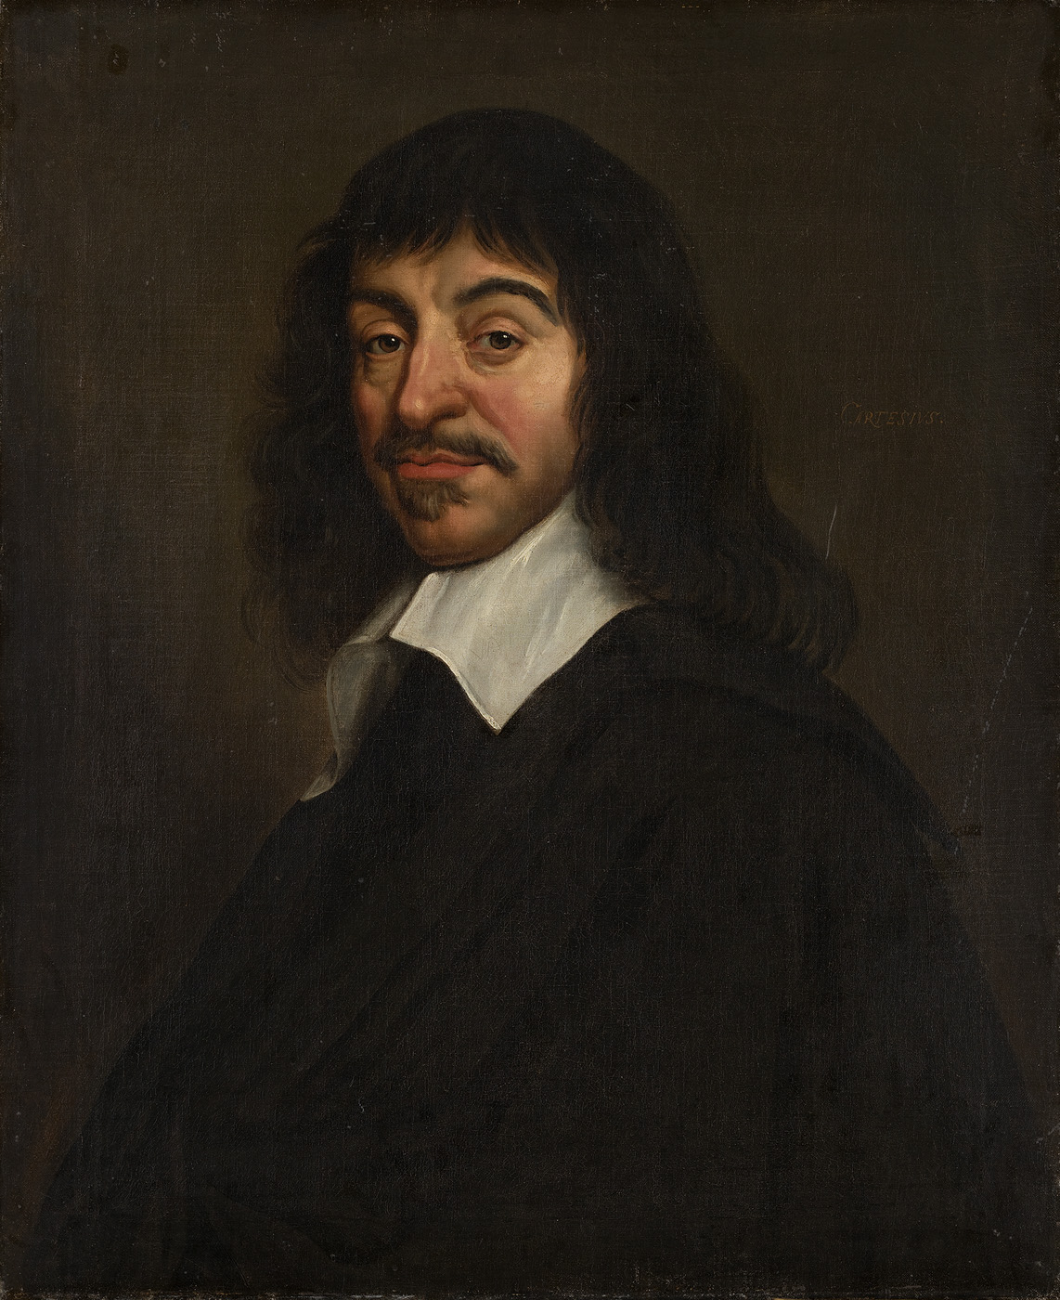
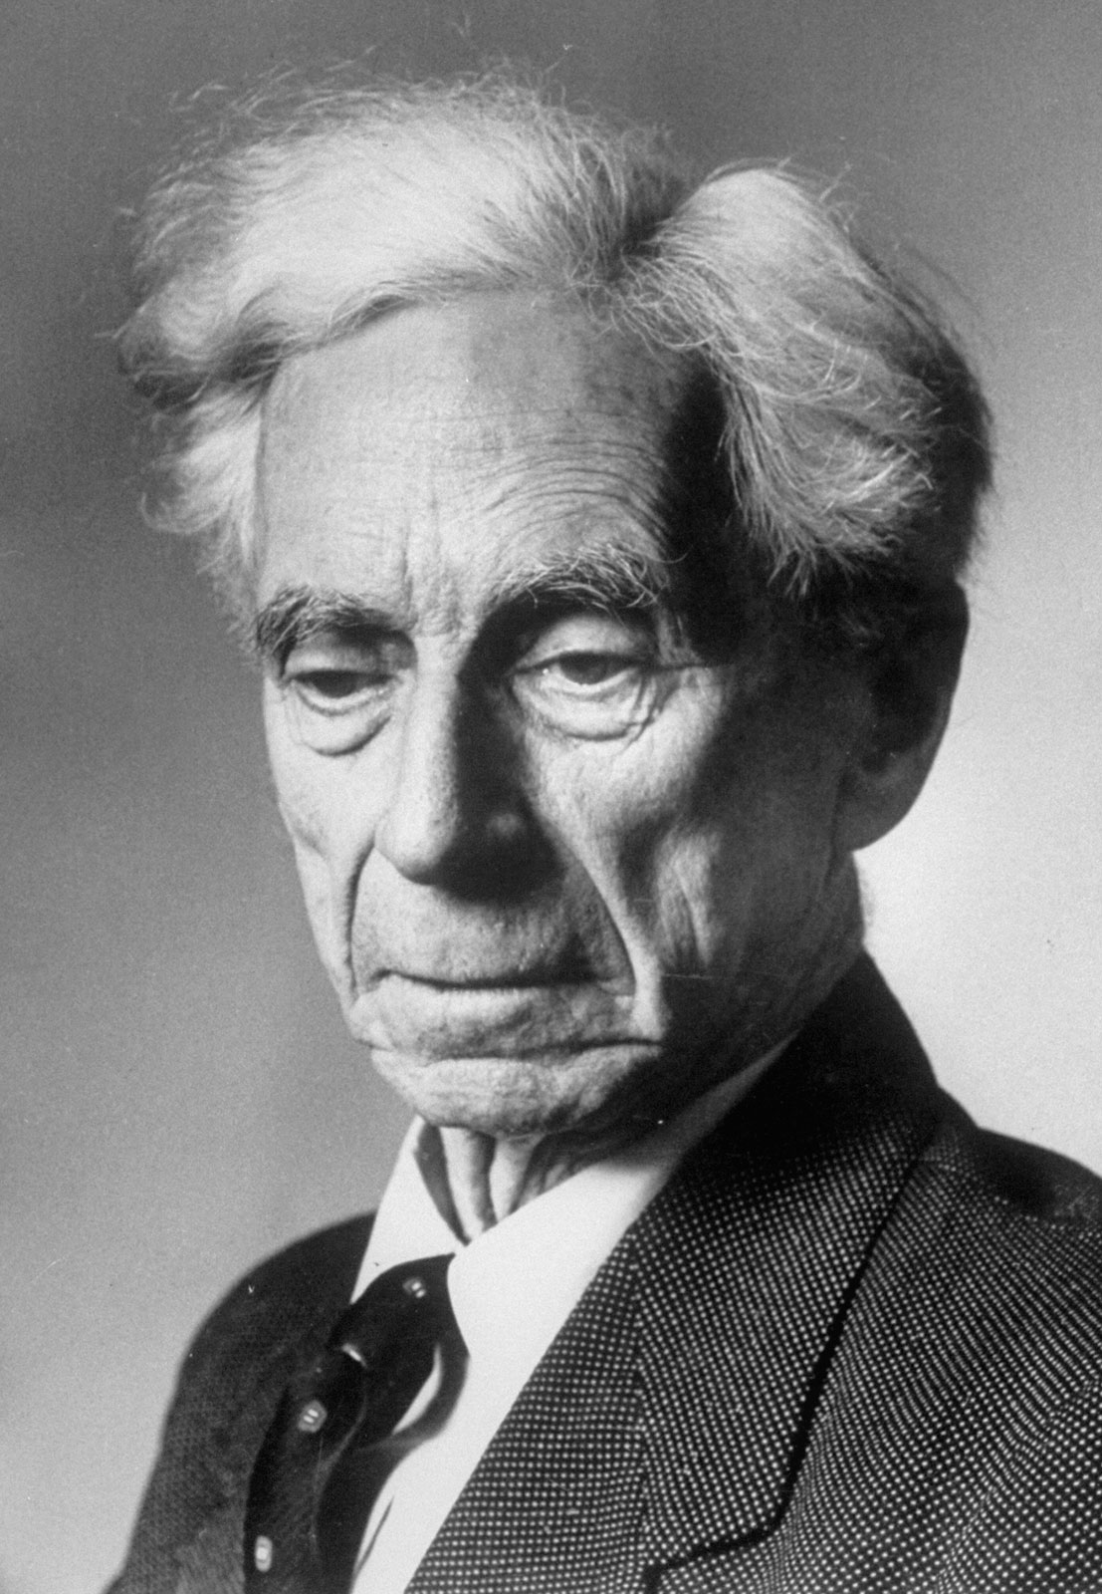
Two versions of foundationalism

Slide 6
Nietzsche’s life & work

Slide 7
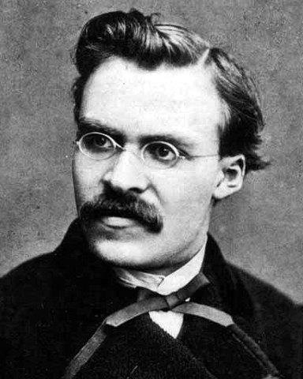
Friedrich Nietzsche (1844-1900)
Born in Roecken, Germany to the family of a Christian minister.
Father dies at the age of 5
Appointed to Professorship in Classical Philology at the University of Basel at age 25.
Friends with Richard Wagner until public falling out.
Retires from the University of Basel for health reasons at 35.
Suffers mental collapse in 1889 ending his writing career.

Slide 8
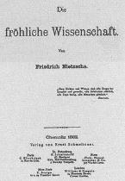
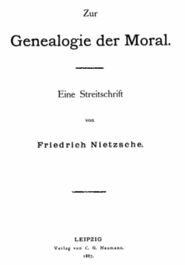
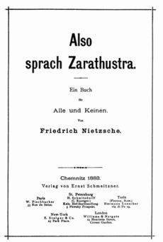

Major Publications by Nietzsche
(1872) Birth of Tragedy
(1878) Human, All Too Human
(1881) Daybreak
(1882) The Gay Science
(1883-5) Thus Spoke Zarathustra
(1886) Beyond Good and Evil
(1887) The Genealogy of Morals
(1889) The Twilight of the Idols
(1894) The Anti-Christ
(1901) The Will to Power (posthumous)
(1908) Ecce Homo (posthumous)

Slide 9
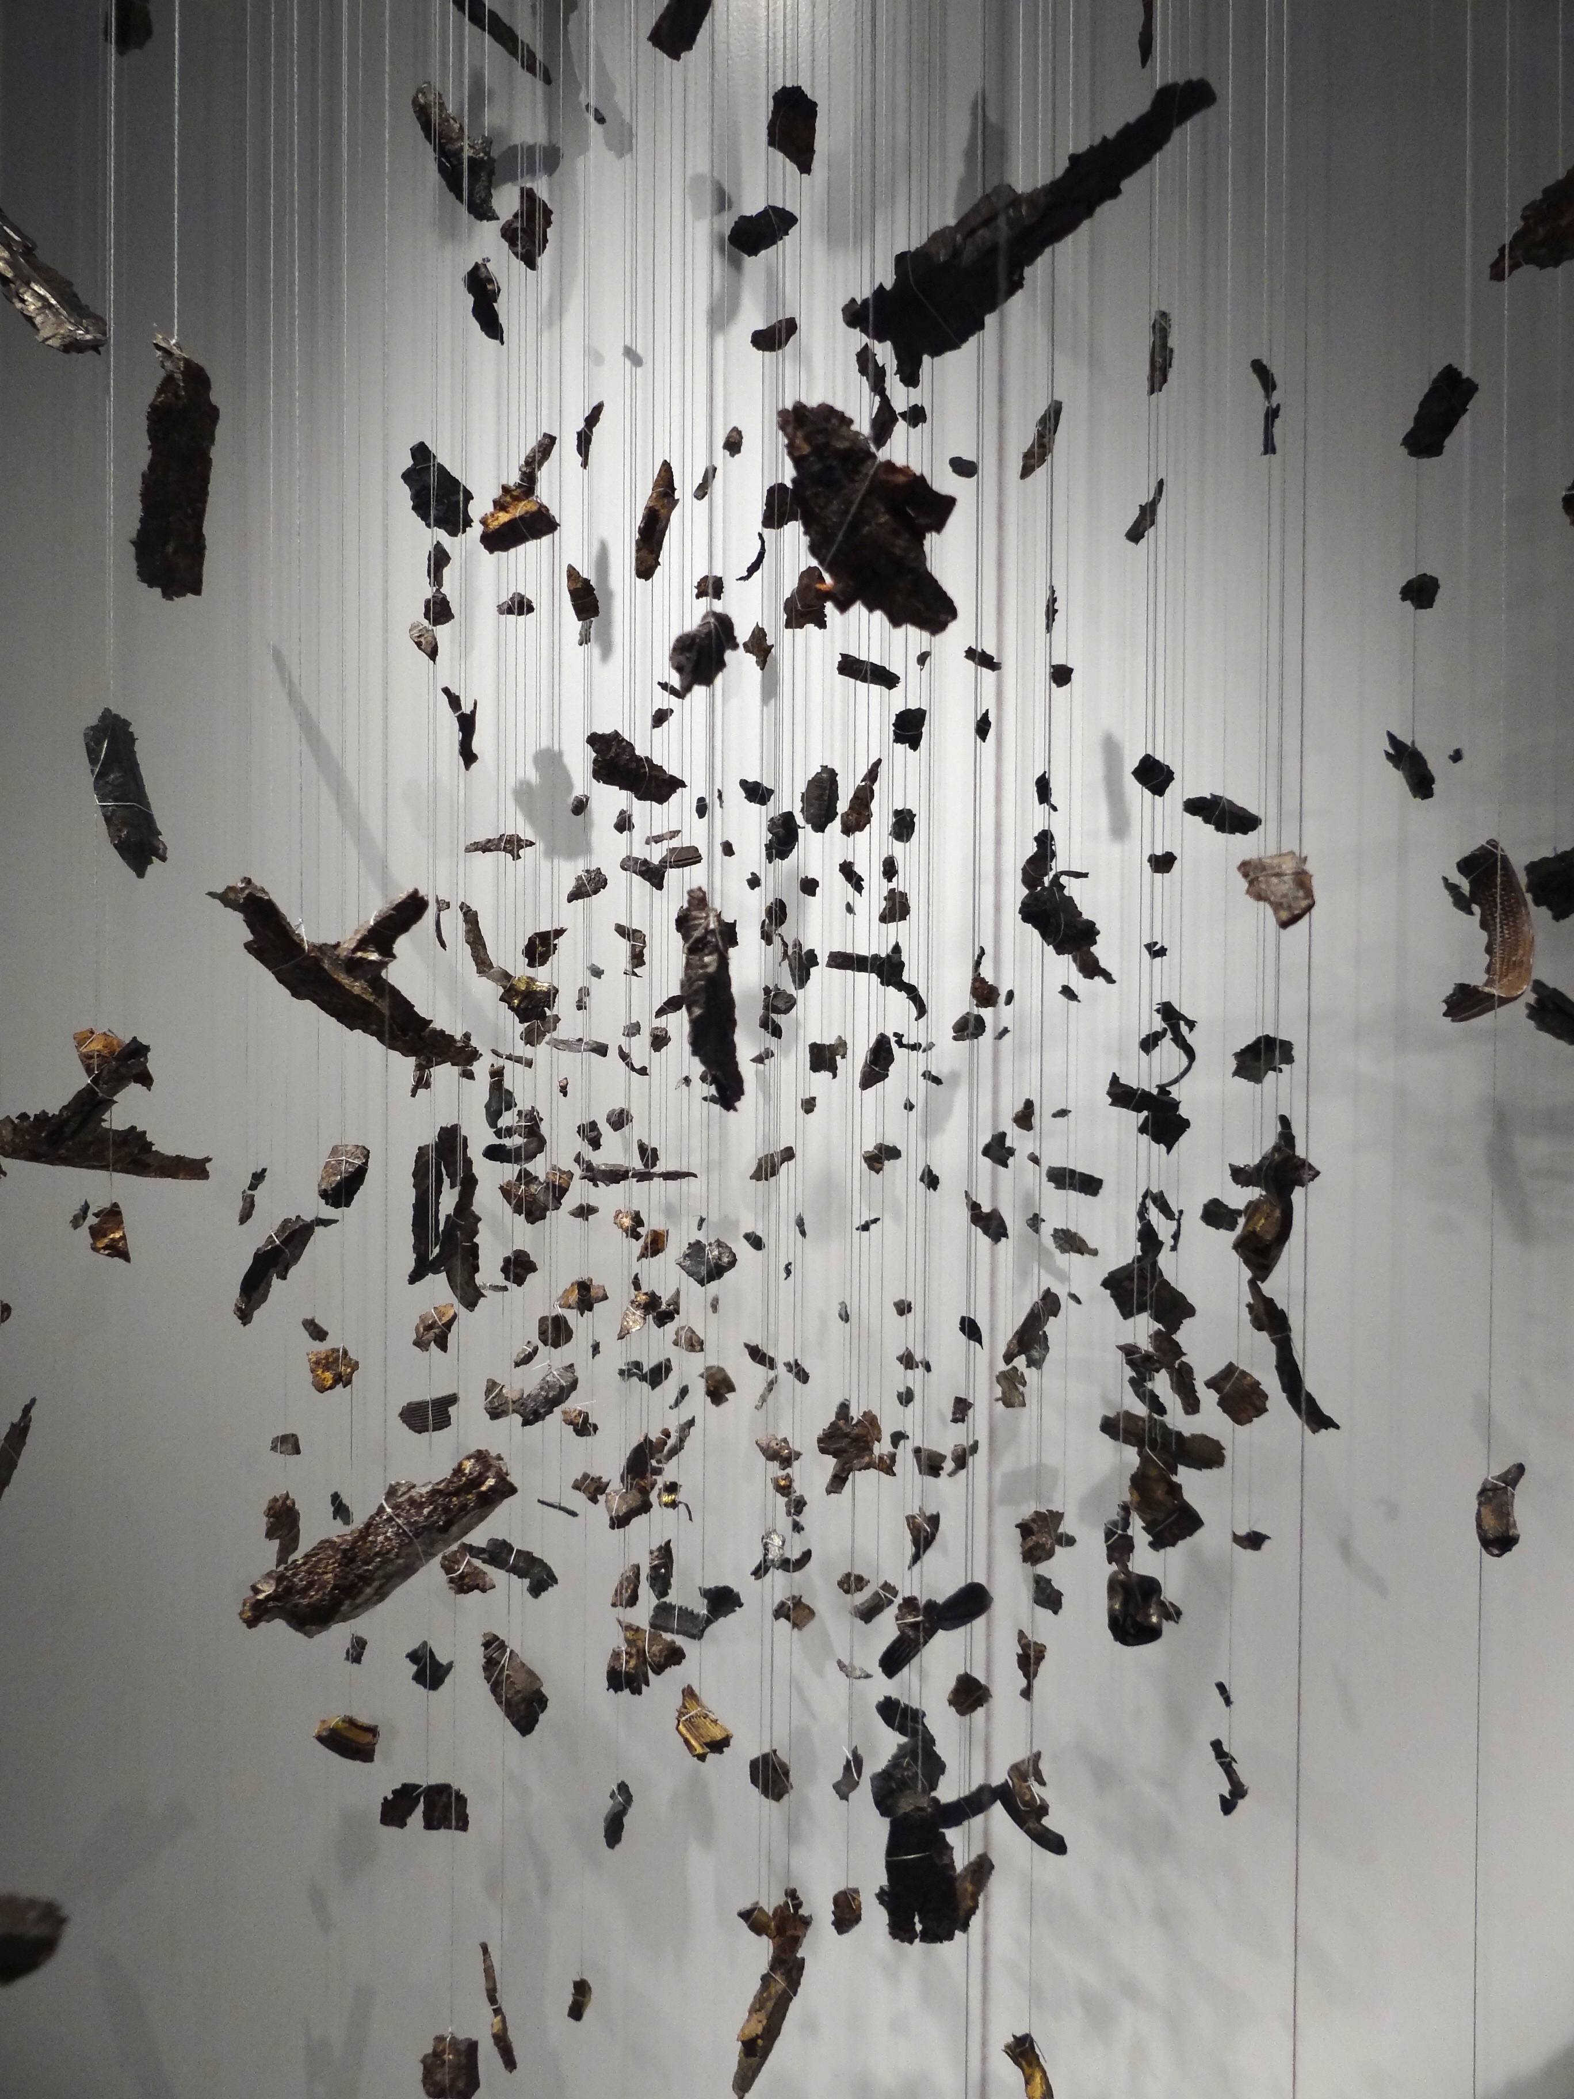
Interpretive challenge
Interpreting Nietzsche’s writings faces the challenge that his work is diverse and fragmentary. It contains many aphorisms as well as other styles of writing (see Nehamas, ch. 1)
“I mistrust all systematizers and avoid them. The will to a system is a lack of integrity.” (TI Maxims and Arrows 26)

Slide 10
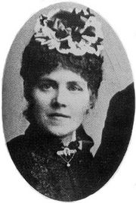
Nietzsche’s literary executor 1
Nietzsche’s sister who was his literary executor after Nietzsche’s collapse and onset of mental illness.
She married anti-Semite Bernard Foerster, who established a German colony in Paraguay called Nueva Germania.
Elisabeth was responsible for distortions of Nietzsche’s reception.
Withheld Ecce Homo for years preventing others from challenging her interpretation of Nietzsche.
Edited Nietzsche’s “final” book Will to Power
Elisabeth Foerster-Nietzsche (1846-1935)
(see Kaufman, preface & ch. 1)

Slide 11
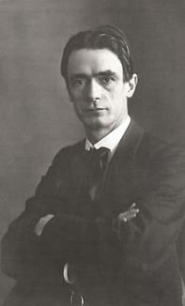
Nietzsche’s literary executor 2
Elisabeth, who was in charge of Nietzsche’s writings, was a poor reader of Nietzsche.
Upon Nietzsche’s collapse, she took lessons in Nietzsche’s Philosophy from Rudolf Steiner, who wrote:
“Frau Foerster-Nietzsche is a complete laywoman in all that concerns her brother’s doctrine… [She] lacks any sense for fine, and even for crude, logical distinctions; her thinking is void of even the least logical consistency; and she lacks any sense of objectivity. She believes at every moment what she says. She convinces herself today that something was red yesterday that most assuredly was blue.” (Steiner quoted in Kaufman, p. 5)
Rudolf Steiner (1861-1925)

Slide 12
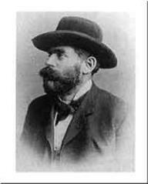
Nietzsche’s relationship to his sister
Selections from Nietzsche’s Letters to Elisabeth:
“You have gone over to my antipodes—I will not conceal that I consider this engagement an insult—or a stupidity which will harm you as much as me.”
“To an enthusiasm for ‘deutsches Wesen’ I have indeed attained very little so far, but even less to the wish to keep this ‘glorious’ race pure. On the contrary, on the contrary.”
Nietzsche describes himself as an “incorrigible European and anti-anti-Semite.”
“Your association with an anti-Semitic chief expresses a foreignness to my whole way of life which fills me ever again with ire or melancholy.”
Bernard Foerster (1843-1889)
(quoted in Kaufman, pp. 43-45)

Slide 13
myths about Nietzsche

Slide 14
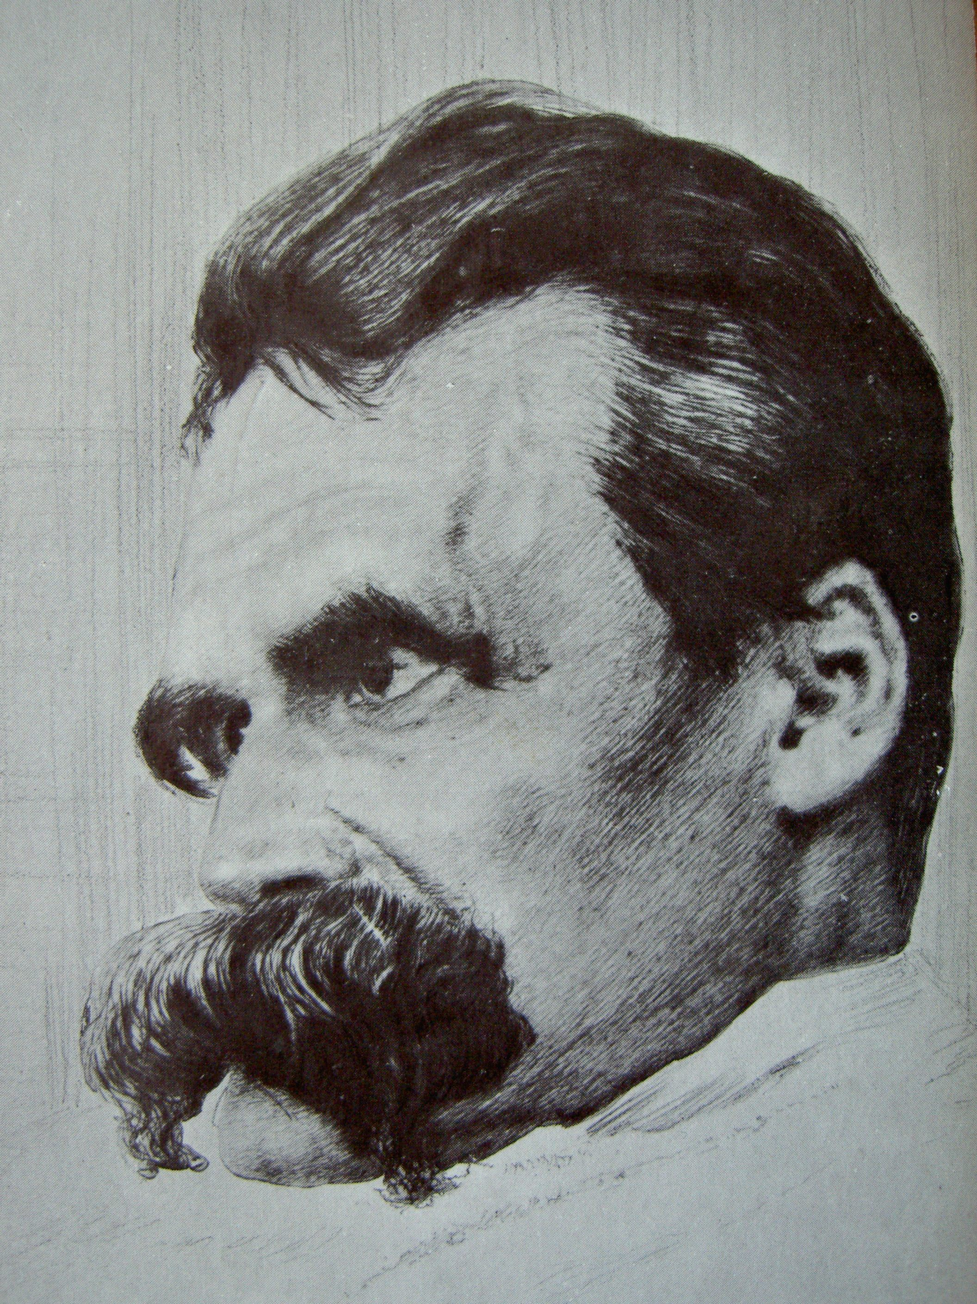
1. Nietzsche was insane
FICTION: His work is the product of insanity and his work drove him to being insane.
FACT: Nietzsche did develop what is suspected to be Syphilis.
FACT: His mental breakdown ended his writing career. His published books were written prior to this event.
(see Kaufman, ch. 1)

Slide 15
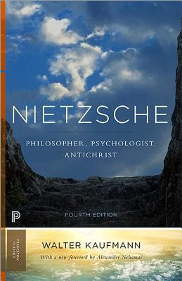
2. Nietzsche was a proto-nazi
FICTION: Nietzsche’s work anticipated the ideas of the Nazi party.
FACT: Nietzsche’s work criticizes the Jewish people for corrupting noble morals with a morality of ressentiment and he did have an idea of a “superman.”
FACT: Nietzsche’s work was used by Nazis for philosophical support but this relied on overlooking certain passages where Nietzsche was critical of Anti-Semitism & German Nationalism.
FACT: Nietzsche’s Sister was anti-Semitic and was in charge of his work. This allowed her to shape its reception in ways that distorted.
(see Kaufman, ch. 1 & 10)

Slide 16
‘The hermeneutics of suspicion’

Slide 17
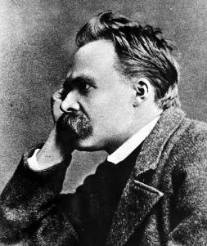
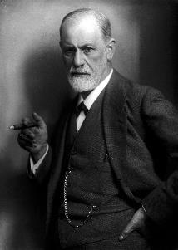
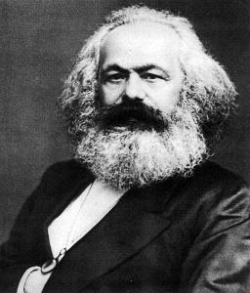
“The Hermeneutics of Suspicion” (P. RiCoeur)
The “hermeneutics of suspicion” is a useful concept for understanding Nietzsche’s project.
It is a method of interpretation that interprets surface phenomena suspiciously, i.e., looking for suppressed motivations & unacknowledged functions.

Slide 18
Perspective in Nietzsche’s critique of morality

Slide 19
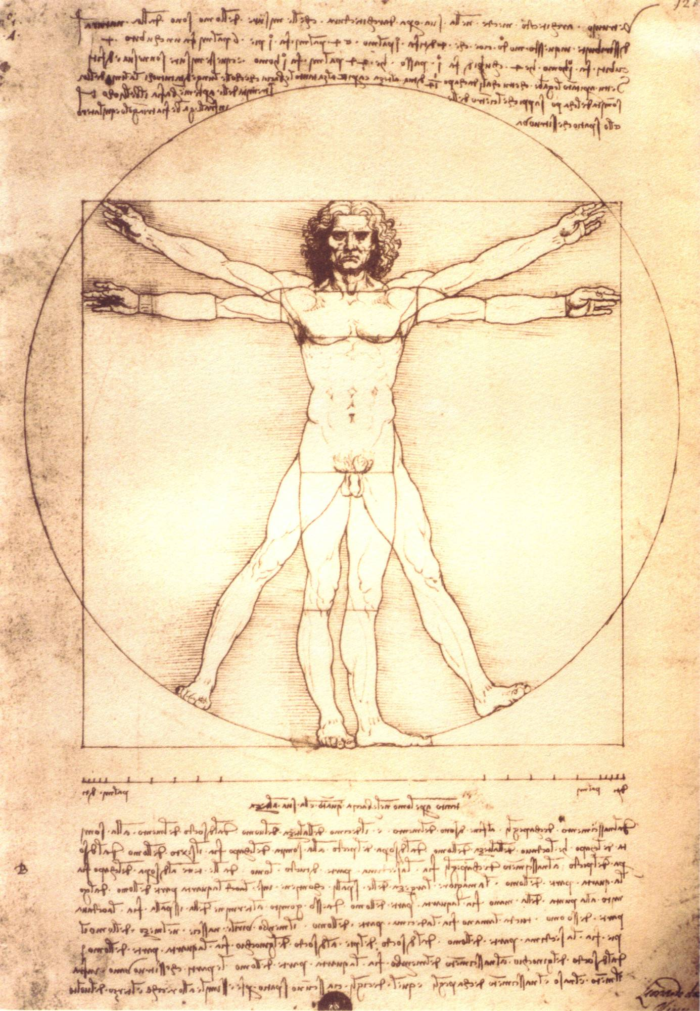
the metaphysical activity of man
A misinterpretation of human nature:
“art, and not morality, is presented as the truly metaphysical activity of man.” (The Birth of Tragedy, preface § 5)

Slide 20
Against moral philosophy
Nietzsche criticizes moral philosophy as resting on an unquestioned assumption—namely, the value of morality.
Moral philosophers “have wanted to supply a rational foundation for morality—and every philosopher so far has believed that he has provided such a foundation. Morality itself, however, was accepted as ‘given’” (Beyond Good & Evil, § 186).
“In all ‘science of morals’ so far one thing was lacking, strange as it may sound: the problem of morality itself; what was lacking was any suspicion that there was something problematic here” (Beyond Good & Evil, § 186).

Slide 21
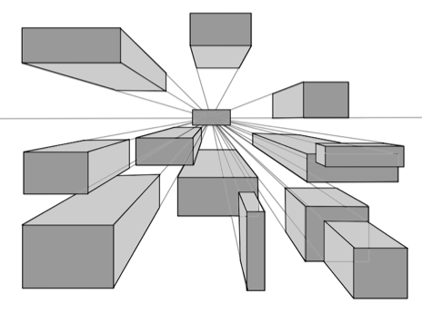
Value & the problem of perspective
Nietzsche questions the very value of morality:
“we stand in need of a critique of moral values, the value of these values itself should first of all be called into question.” (GM, § 6)
This raises the question: from what evaluative standpoint should we evaluate moral values?

Slide 22
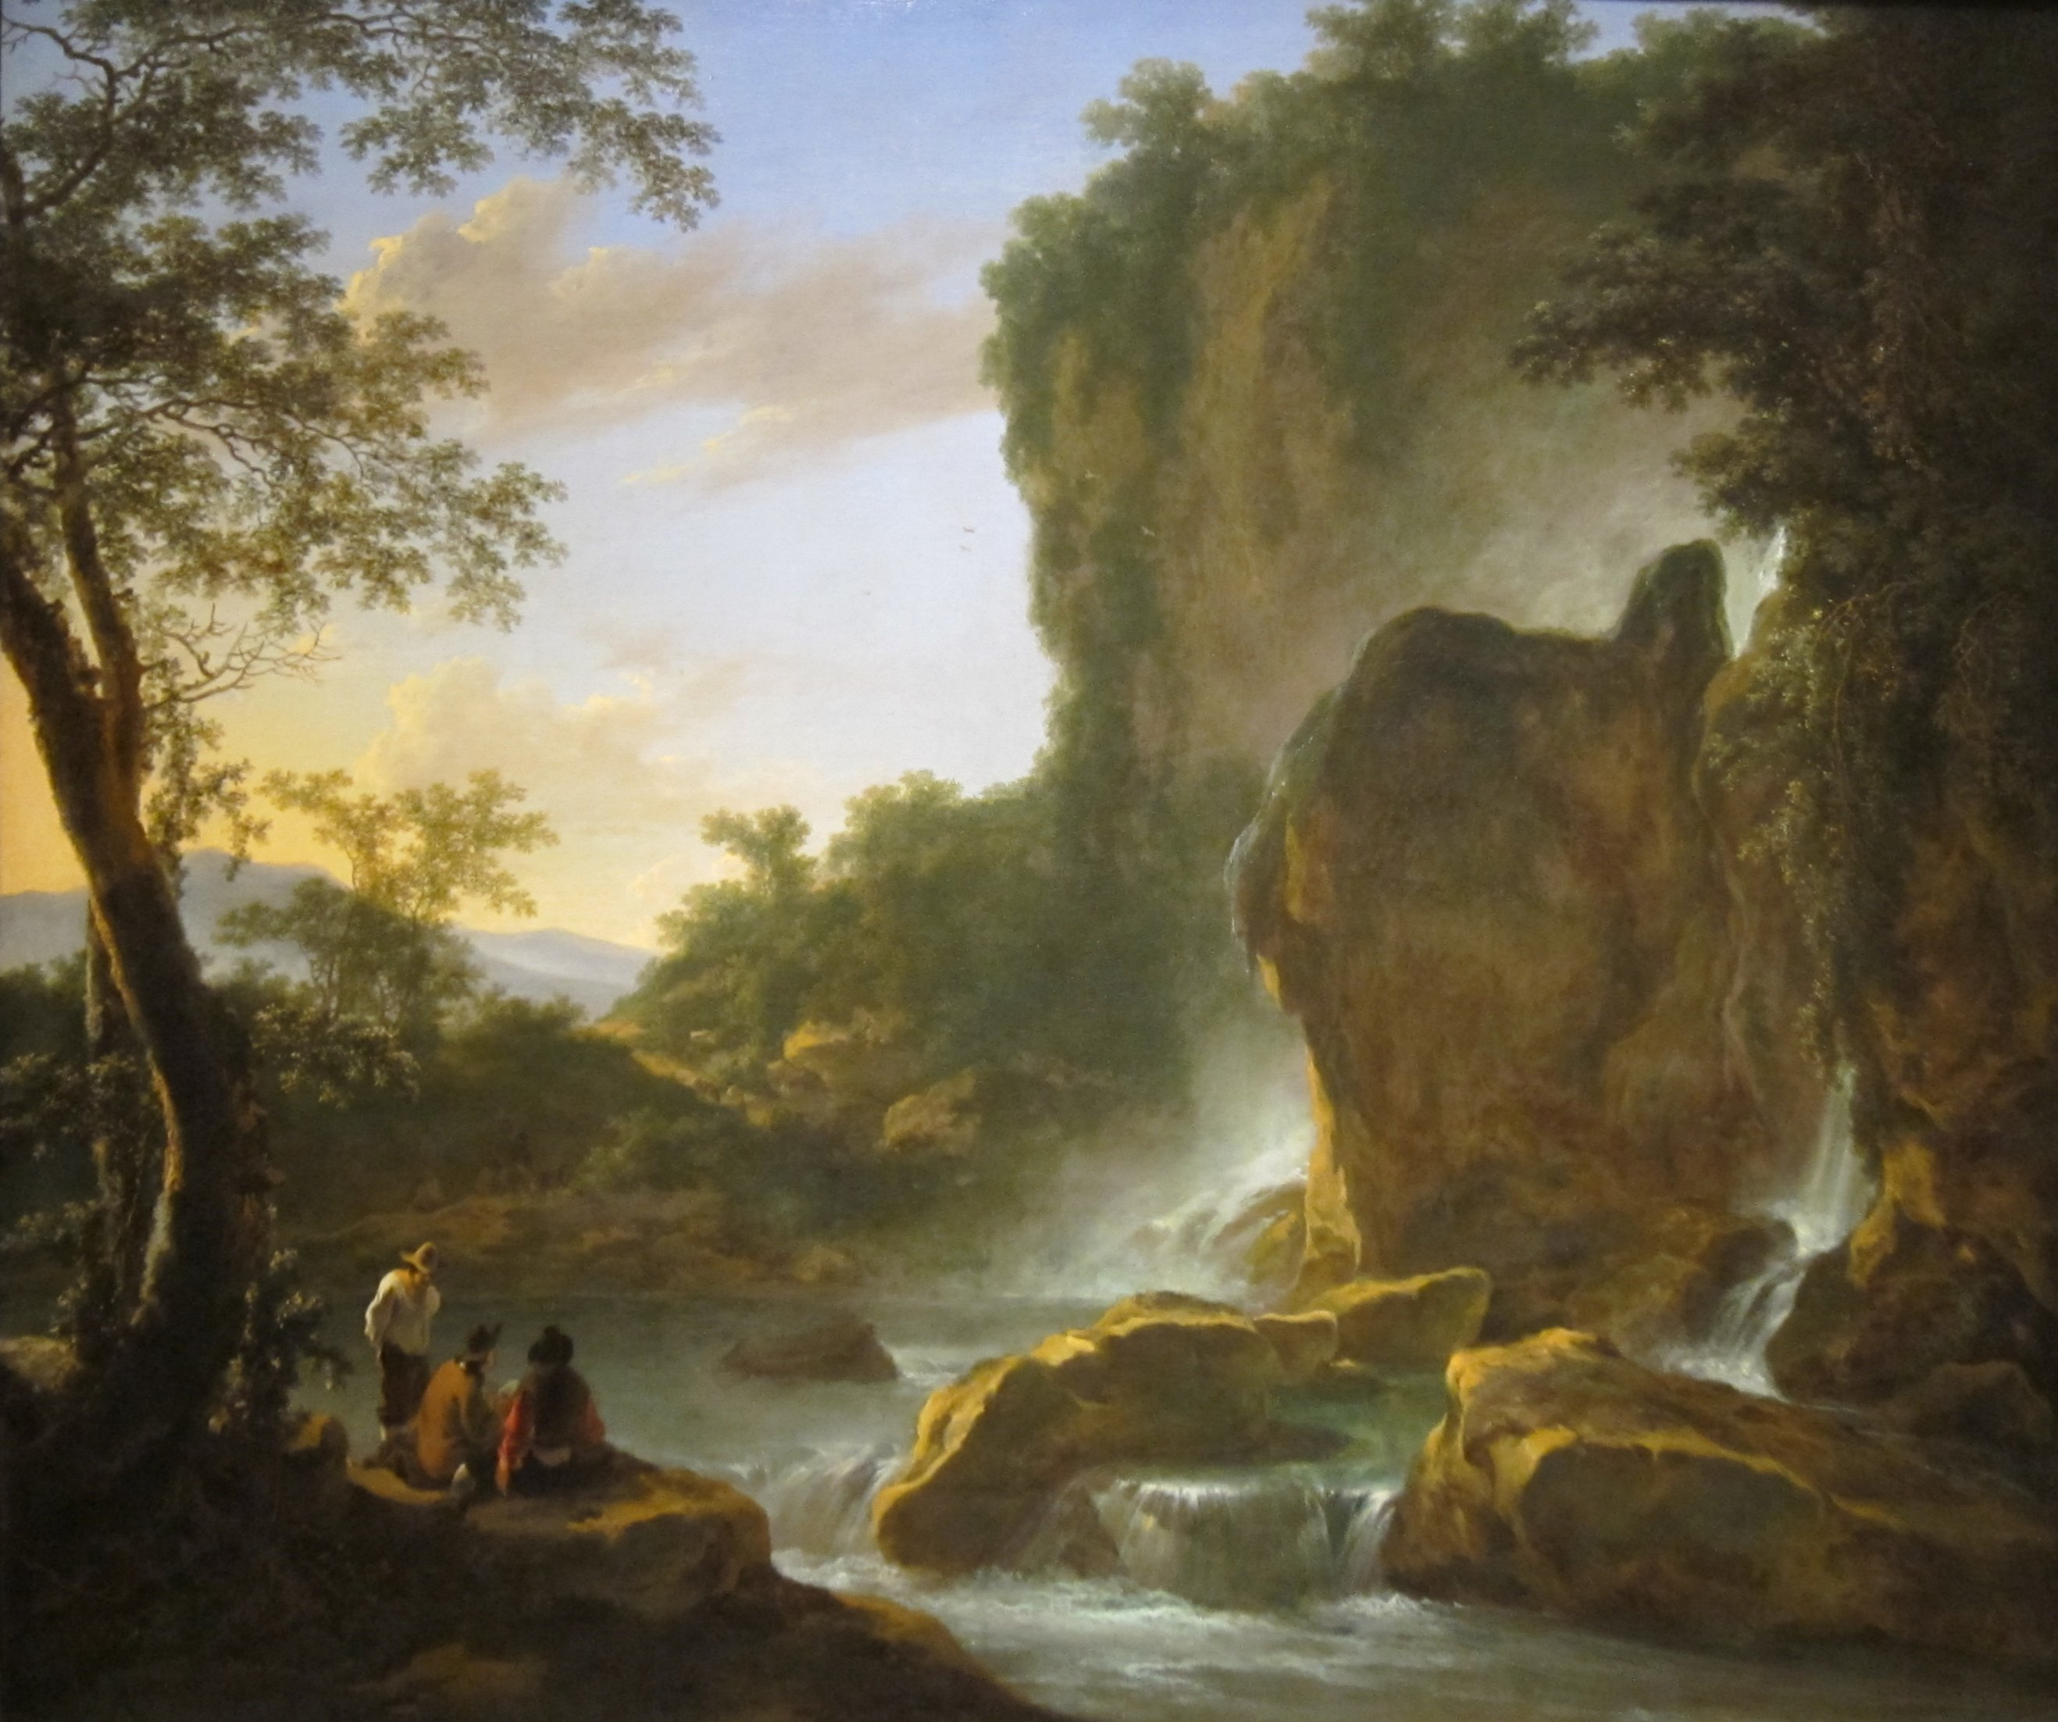
Morality seen from the perspective of life
Nietzsche proposes that we reconsider the value of morality from the perspective of life:
“the gravest question of all” = “What, seen in the perspective of life is the significance of morality?” (The Birth of Tragedy, preface § 4)

Slide 23
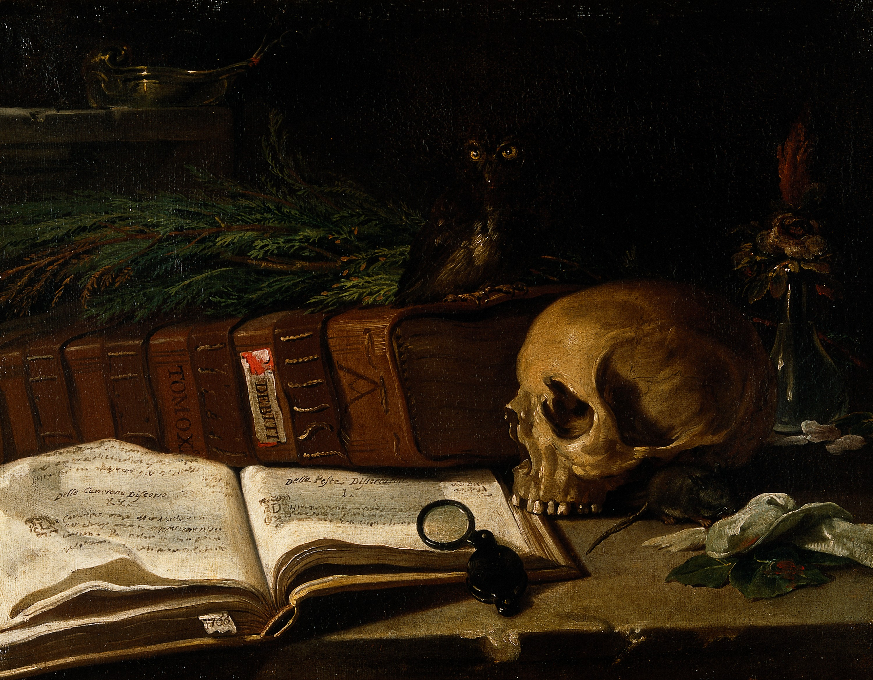
A natural history of morals
Nietzsche examines morality as a natural phenomenon. Morality emerges within the course of human history as a natural phenomenon.
He urges us to “compare many moralities” to arrive at the true question—namely, the value of morality (Beyond Good and Evil §186).
“There are moralities which are meant to justify their creator before others. Other moralities are meant to calm him and lead him to be satisfied with himself. With yet others he wants to crucify himself and humiliate himself. With others he wants to wreak revenge, with others conceal himself, with others transfigure himself and place himself up, at a distance…” (Beyond Good & Evil, § 187).

Slide 24
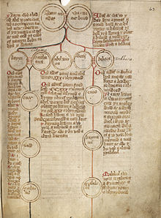
Nietzsche’s genealogical method
Nietzsche’s method of looking for the historical origin of our ideas of ‘good’ and ‘evil’.
“under what conditions did man invent the value-judgments good and evil? Have they helped or hindered the progress of mankind? Are they a sign of indigence, of impoverishment, of the degeneration of life?” (GM, Preface § 3)
Nietzsche suggests that our ordinary understanding of moral concepts rests on a mistake—a false interpretation.
Like a family genealogy, which traces out one’s origins biological origins, Nietzsche’s genealogical method looks for the deeper, hidden origins of morality.

Slide 25
Nietzsche’s suggestion
The meaning of the term ‘good’ underwent a historical change when one system of values gave way to another in a massive evaluative sea change.
Good/Bad
Good/Evil

Slide 26
The “Trans-valuation of Values”
Noble Morality
‘Good’/‘Bad’
Slave Morality
‘Good’/‘Evil’
Evaluations rooted in ressentiment/hatred of the powerful. It involves a turn against our natural instinct for life.
Evaluations rooted in our instincts toward life & feelings of power
“good = noble = powerful = beautiful = happy” (GM, § 7)
It is essentially reactive in nature (GM § 10)

Slide 27
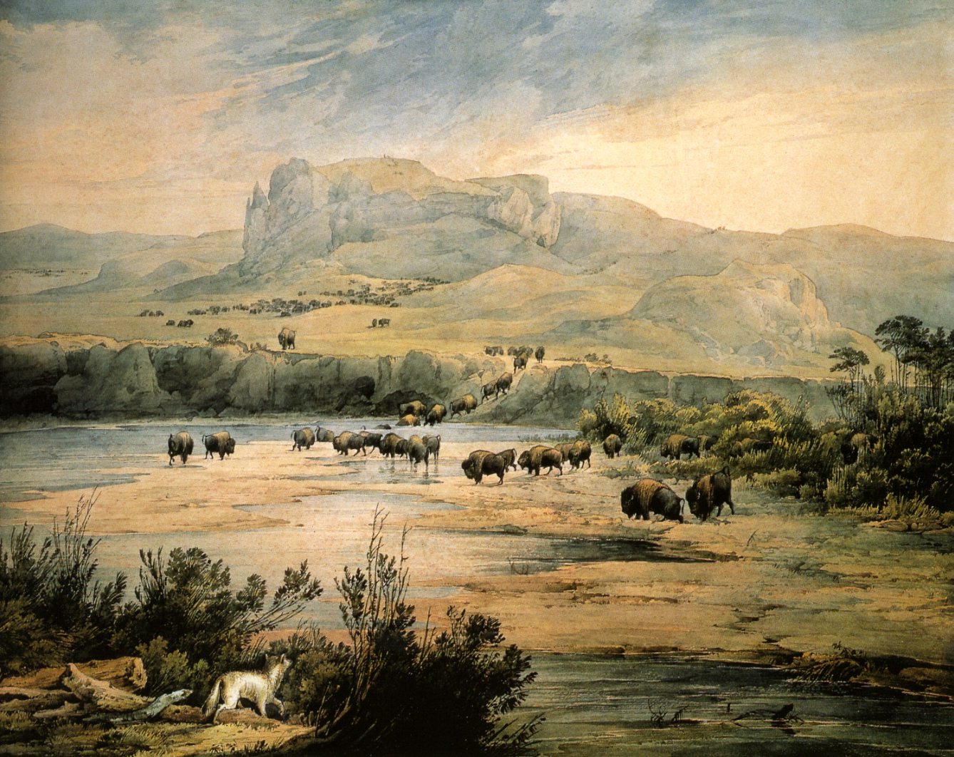
Herd morality
Nietzsche criticizes common morality as that of a ‘herd’.
“The highest and strongest drives, when they break out passionately and drive the individual far above the average and the flats of herd conscience, wreck the self-confidence of the community, its faith in itself, and it is as if its spine snapped. Hence just these drives are branded and slandered most. High and independent spirituality, the will to stand alone, even a powerful reason are experienced as dangers; everything that elevates an individual above the herd and intimidates the neighbor is henceforth called evil, and the fair, modest, submissive, conforming mentality, the mediocrity of desires attains moral designations and honors.” (Beyond Good and Evil, § 201).
“the imperative of herd timidity: ‘we want that some day there should be nothing any more to be afraid of!’” (Beyond Good and Evil, § 201).

Slide 28
The Re-evaluation of Values
Nietzsche’s critique of Christian morality looks at it from the perspective of our instincts to life.
Nietzsche’s noble morality looks at cultural phenomenon in relation to the creation of “higher” sorts of individuals, those who embody the drive to life most fully, e.g., artists.
Nietzsche calls for a return of an ethic of nobility.
“What is good? All that heightens the feeling of power, the will to power, power itself in man. What is bad? All that proceeds from weakness. What is happiness? The feeling that power increases that a resistance is overcome.” (AC, § 2)

Slide 29
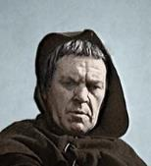
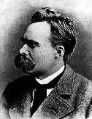
Jasagen
Nietzsche encourages us to say “yes” to life, to affirm its impulses as healthy.
He sees decline and decadence in the tendency to say “no” to life encouraged by Christian morality and its modern successors.
NO!
YES!

Slide 30
Life & truth

Slide 31

Life-enhancing errors
Nietzsche argues that some errors have proven to be conducive to life:
“Throughout tremendous periods of time the intellect begot nothing but errors; some of them proved useful and preservative of the species: he who came upon them or inherited them fought his fight for himself and his posterity with greater good fortune. These articles of belief which have been repeatedly handed down and have finally become almost a basic component of the human species, are for example the following: that there are enduring things, that there are identical things, that there are things, material, bodies, that a thing is what it appears to be, that our willing is free, that what is good for me is good in itself…It seemed one was incapable of living with truth, our organism was adapted to the opposite; all its higher functions, the perceptions of the senses and every kind of sensation in general worked in concert with those primevally incorporated fundamental errors.” (GS §110)

Slide 32
‘untruth as a condition of life’
“The falseness of a judgment is for us not necessarily an objection to it; in this respect our new language may sound strangest. The question is to what extent it is life-promoting, life-preserving, species-preserving, perhaps even species-cultivating. And we are fundamentally inclined to claim that the falsest judgments (which include the synthetic judgments a priori) are the most indispensable for us; that without accepting the fictions of logic, without measuring reality against the purely invented world of the unconditional and self-identical, without a constant falsification of the world by means of numbers, man could not live—that renouncing false judgments would mean renouncing life and a denial of life. To recognize untruth as a condition of life—that certainly means resisting accustomed value feelings in a dangerous way; and a philosophy that risks this would by that token alone place itself beyond good and evil.” (BGE § 4)

Slide 33


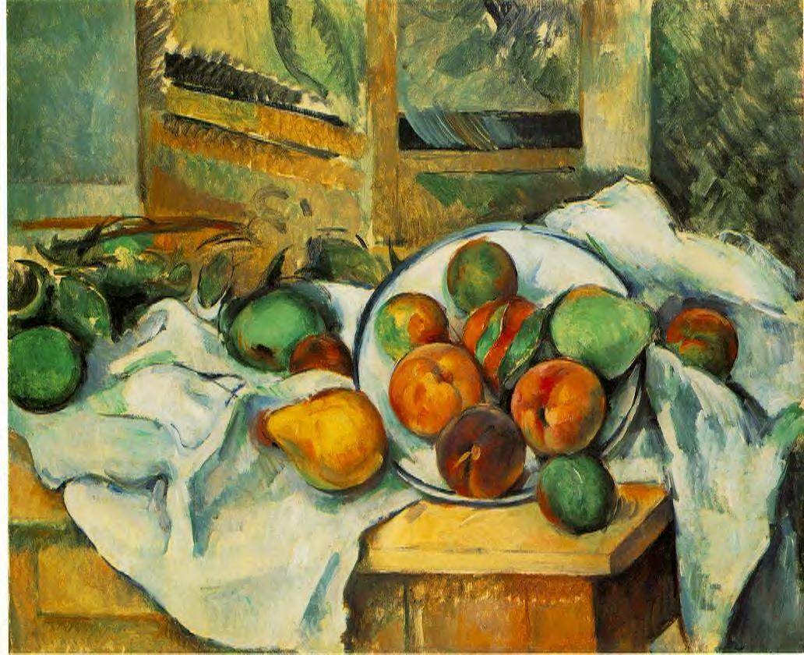
Value of truth?
“Is it no more than a moral prejudice that truth is worth more than mere appearance; it is even the worst proved assumption there is in the world. Let at least this much be admitted: there would be no life at all if not on the basis of perspective estimates and appearances; and if, with the virtuous enthusiasm and clumsiness of some philosophers, one wanted to abolish the ‘apparent world’ altogether—well, supposing you could do that, at least nothing would be left of your ‘truth’ either. Indeed, what forces us at all to suppose that there is an essential opposition of ‘true’ and ‘false’? Is it not sufficient to assume degrees of apparentness and, as it were, lighter and darker shadows and shades of appearance—different ‘values,’ to use the language of painters?” (BGE §34)

Slide 34
The death of god

Slide 35
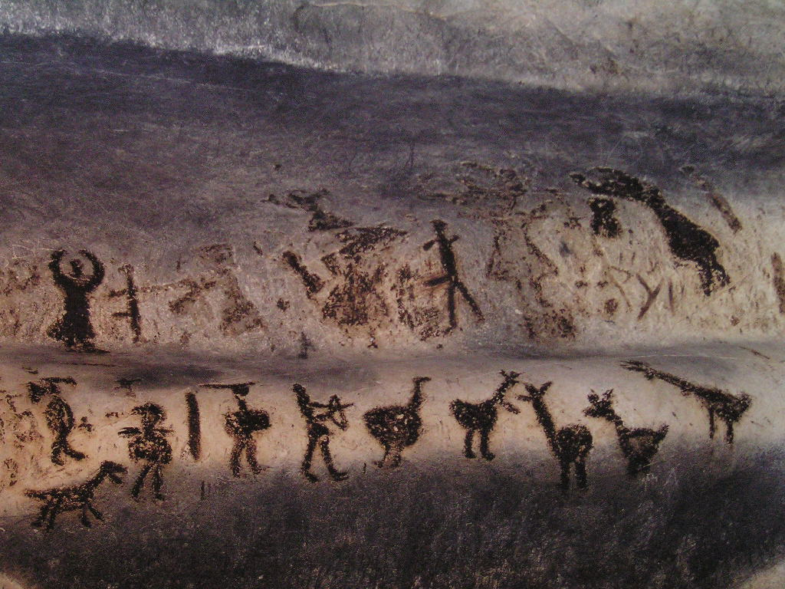
God’s Shadow?
“New Struggles—After Buddha was dead, his shadow was still shown for centuries in a cave—a tremendous, gruesome shadow. God is dead; but given the way of men, there may still be caves for thousands of years in which his shadow will be shown—And we—we still have to vanquish his shadow, too.” (The Gay Science,§108).

Slide 36
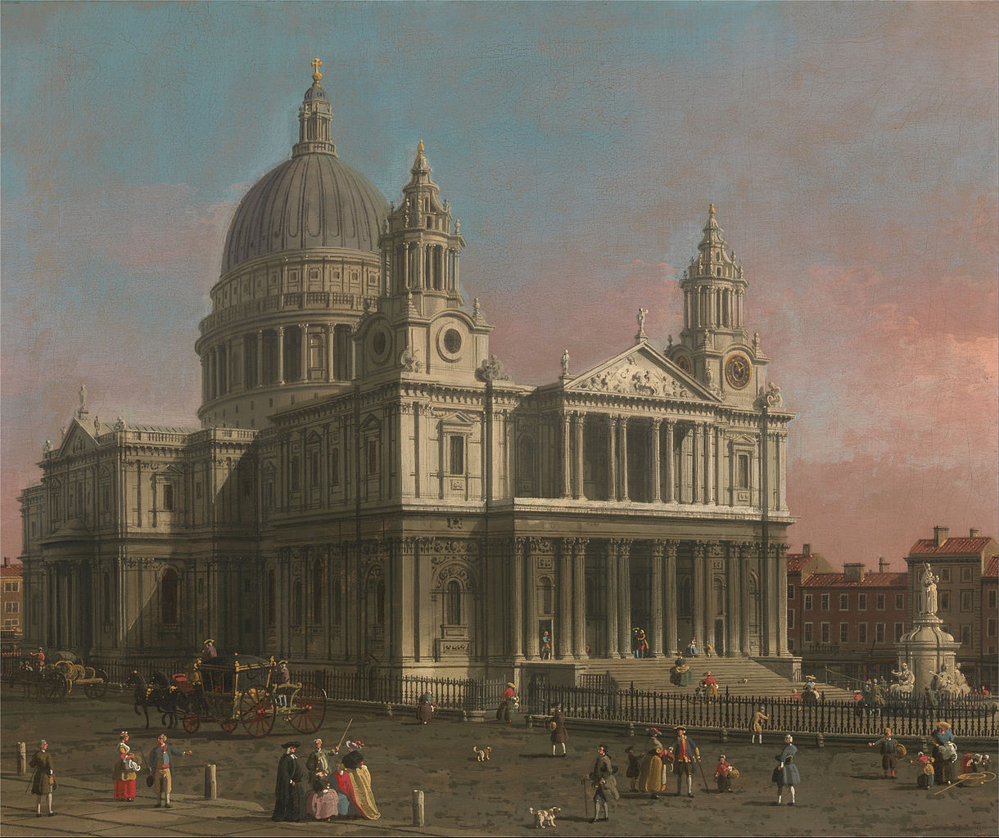
Nietzsche’s ‘madman’
Close reading of The Gay Science § 125.
Whom does the madman address as his audience?
What does the madman suggest the implication of ‘God’s death’ is?
What does it mean that this has not yet been recognized?

Slide 37
Meaning of the ‘death of god’
Nietzsche’s announcement of the ‘Death of God’ is NOT an argument against God’s existence—rather it takes God’s non-existence for granted.
Nietzsche is arguing that Europe has not yet come to terms with the full implications of God’s non-existence—his “shadow” still haunts them.
The ‘shadow’ of God can be seen in the persistence of certain theistic derivatives, including the secular descendants of Christian morality.
“Christianity is a system, a consistently thought out and complete view of things. If one breaks out of it a fundamental idea, the belief in God, one thereby breaks the whole thing to pieces: once has nothing of any consequence left in one’s hands” (Twilight of the Idols, “Expeditions of an Untimely Man § 5).

Slide 38
Science as metaphysical faith
“Thus the question ‘Why science?’ leads back to the moral problem: Why have morality at allow when life, nature, and history are ‘not moral’? No doubt, those who are truthful in that audacious and ultimate sense that is presupposed by the faith in science thus affirm another world than the world of life, nature, and history; and insofar as they affirm this ‘other world’—look, must they not by the same token negate its counterpoint, this world, our world?—But you will have gathered what “I am driving at, namely, that it is still a metaphysical faith upon which our faith in science rests—that even we seekers after knowledge today, we godless anti-metaphysicians still take our fire, too, from the flame lit by a faith that is thousands of years old, that Christian faith which was also the faith of Plato, that God is the truth, that truth of the divine. But what if this should become more and more incredible, if nothing should prove to be divine ay more unless it were error, blindness, the lie—if God himself should prove to be our most enduring lie?” (GS, § 344)

Slide 39
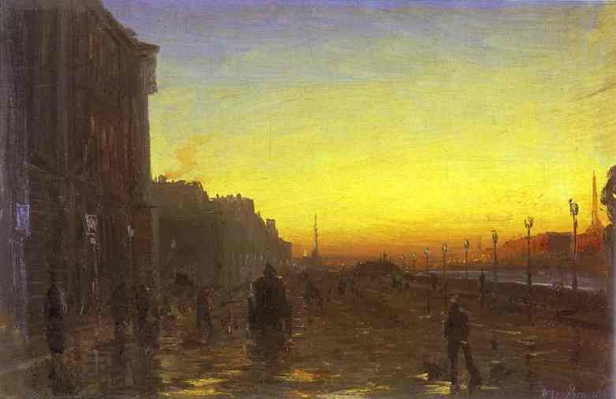
Reaction of the ‘free spirits’ to god’s death
“we philosophers and ‘free spirits’ feel, when we hear the news that ‘the old god is dead’, as if a new dawn shone on us; our heart overflows with gratitude, amazement, premonitions and expectation. At long last the horizon appears free to us again, even if it should not be bright; at long last our ships may venture out again, venture out to face any dancer; all the daring of the lover of knowledge is permitted again; the sea, our sea, lies open again; perhaps there has never yet been such an ‘open sea.’” (GS § 280)

Slide 40
nietZsche’s perspectivism

Slide 41
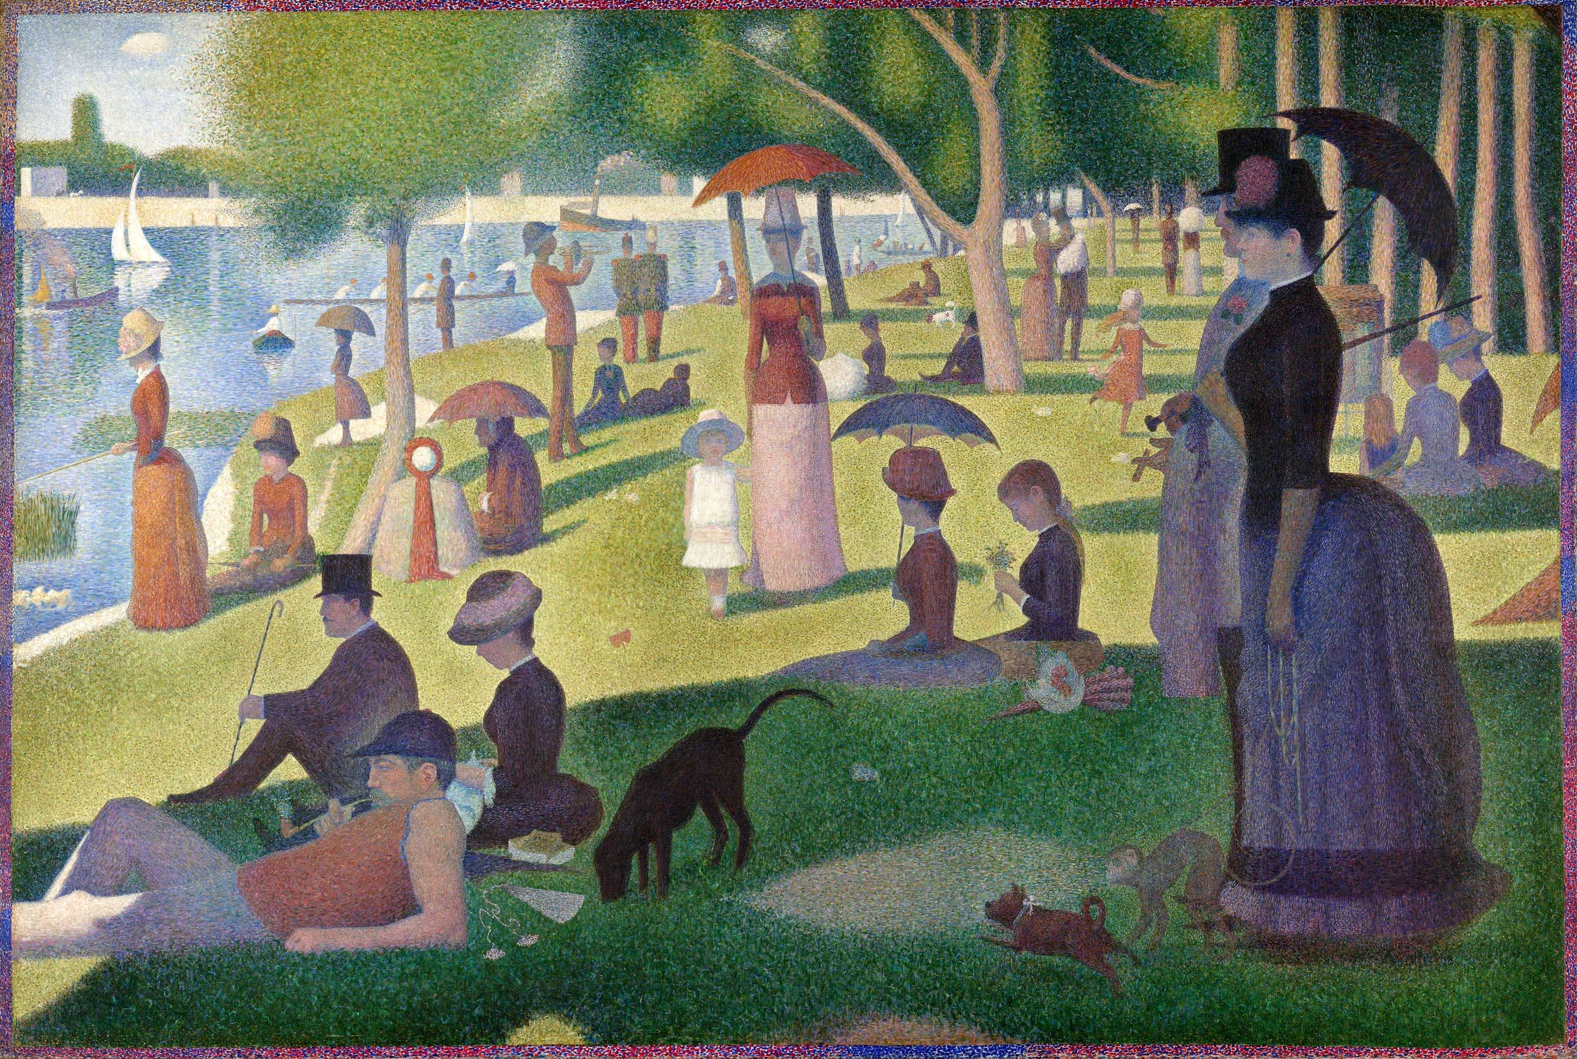
Example of perspective: Pointillism

Slide 42
perspectivism
“no, facts are precisely what there are not, only interpretations. We can establish no fact ‘in itself’; perhaps it is nonsense to desire such a thing. ‘Everything is subjective’, you may say, but that is already an interpretation; the ‘subject’ is not something given, but an embellishment, an interpolation” (Will to Power §481).
“In so far as the word ‘knowledge’ has any meaning at all, the world is knowable. It may however be interpreted differently; it has no meaning behind it, but rather innumerable meanings which can be assigned to it. Hence ‘perspectivism’” (Will to Power §481).

Slide 43
Is nietzsche’s theory self-undermining?
Does Nietzsche’s perspectivalism undermine itself & the rest of Nietzsche’s thought?
“But if the view that there are only interpretations is itself only an interpretation, and therefore possibly wrong, it may seem to follow that not every view is after all an interpretation and that Nietzsche’s position undermines itself.” (Nehamas, p. 1)
“Does he [Nietzsche] not, then, think that his view of the self, of morality, or of history, many of which are themselves at least apparently paradoxical, are true?” (Nehamas, p. 2)

Slide 44
Nietzsche’s Übermensch

Slide 45
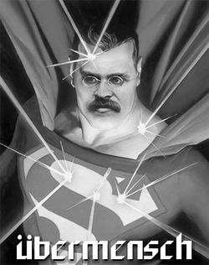
What the Übermensch isn’t
Übermensch ≠ racial category: Nietzsche’s Übermensch (sometimes translated as ‘overman’ or ‘superman’ is not a racial category—his references to higher types refer to nobility from various cultures and ethnicities.
(See Kaufmann, ch. 10 & 11)

Slide 46

Self-Creation
Übermenschen create themselves:
“Let us therefore limit ourselves to the purification of our opinions and evaluations and to the creation of our own new tables of values…We, however, want to be those who we are--the new, the unique, the incomparable, those who give themselves their own law, those who create themselves.” (Gay Science, § 335)
“In man, creature and creator are united: in man there is matter, fragment, excess, clay, dirt, nonsense, chaos; but in man there is also creator, formgiver, hammer hardness, spectator divinity and the seventh day—do you understand this contrast?” (Beyond Good and Evil, § 225)

Slide 47
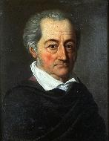
Examples
Nietzsche thought Napoleon, Caesar, and Goethe embodied the values of the Übermensch.
Goethe shows how the Übermensch need not be a warrior & can indeed be tolerant with the right motivation: “What he aspired to was totality; he strove against the separation of reason, sensuality, feeling, will…he disciplined himself as a whole, he created himself…Goethe conceived of a strong, highly cultured human being, skilled in all physical accomplishments, who, keeping himself in check and having reverence for himself, dares to allow himself the whole compass and well of naturalness, who is strong enough for freedom; a man of tolerance, not out of weakness, but out of strength..” (Twilight of the Idols, § 49)
(See Kaufmann, p. 316)

Slide 48
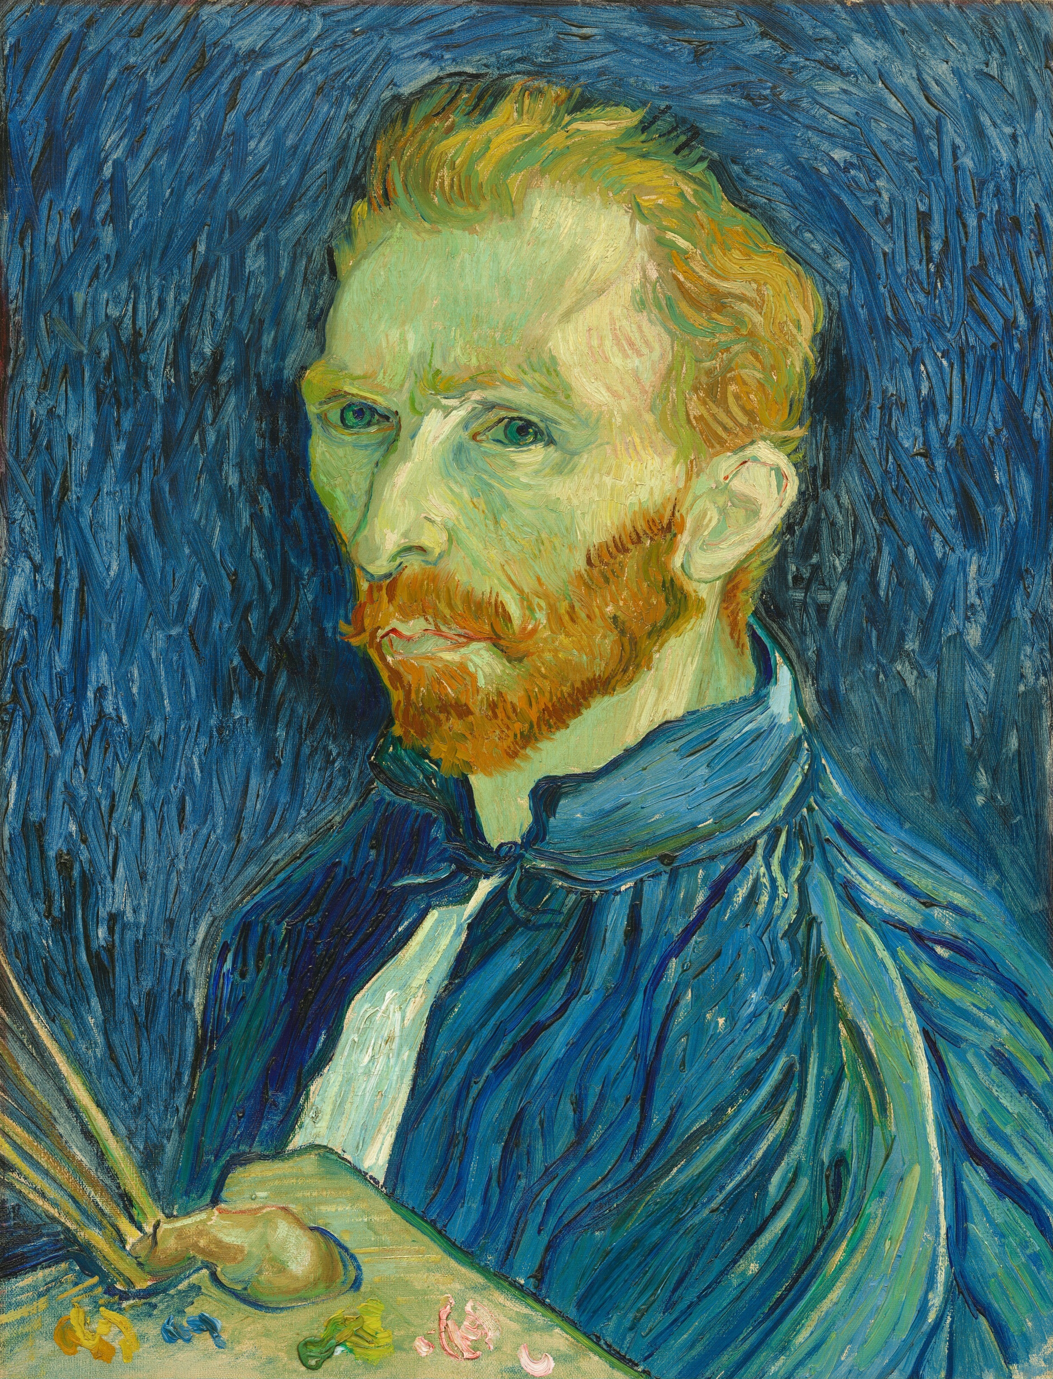
Grand style
“The highest feeling of power and security finds expression in that which possesses grand style. Power which no longer requires proving; which disdains to please; which is slow to answer; which is conscious of no witness around it; which lives oblivious of the existence of any opposition; which reposes in itself, fatalistic, a law among laws: that is what speaks of itself in the form of grand style.”
(Twighlight of the Idols, “Expeditions of an Untimely Man,” §11; cf. Ferry, pp. 84-93).

Slide 49
übermensch as end, not means
The Übermensch is neither valued as a means to some further end, e.g., survival of the species or political revolution nor is the Übermensch another species that evolves out of human beings.
“For Nietzsche, the overman does not have instrumental value for the maintenance of society: he is valuable in himself because he embodies the state of being that has the only ultimate value there is; and society is censured insofar as it insists on conformity and impedes his development” (Kaufmann, pp. 313-4).

Slide 50
The eternal recurrence

Slide 51
4 ways to think about history
Progressive
Cyclical
Eschatological
Drifting

Slide 52

Universe as hour-glass
“we know what you teach: that all things recur eternally and we ourselves within them, and that we have already existed an infinite number of times before and all things with us...like an hour-glass, turn itself over again and again, so that it may run down and run out anew.” (Zarathustra III, “The Convalescent”)

Slide 53
Amor fati
“My formula for greatness in a human being is amor fati: that one wants nothing to be different, not forward, not backward, not in all eternity. Not merely to bear what is necessary, still less conceal it…but love it.” (Ecce Homo, “Why I am So Clever” 10)
“Did you ever say Yes to one joy? O my friends, then you said Yes to all woe as well. All things are chained and entwined together, all things are in love; if ever you wanted one moment twice, if ever you said ‘You please me, happiness, instant, moment!’ then you wanted everything to return! You wanted everything anew, everything eternal, everything chained, entwined together, everything in love, O that is how you loved the world, you everlasting men, loved it eternally, and for all time: and you say even to woe: ‘Go, but return!’ For all joy wants—eternity!” (Zarathustra IV, “Intoxicated Song”)
(See Kaufmann, ch. 11)

Slide 54
bibliography
Barret, W. (1958). Irrational Man: A Study in Existential Philosophy. Anchor Books.
Danto, A. (1965). Nietzsche as Philosopher. Columbia UP.
Flynn, T. (2006). Existentialism: A Very Short Introduction. Oxford UP.
Kaufmann (1974) Nietzsche: Philosopher, Psychologist, and Anti- Christ. Princeton University Press.
Kaufmann (ed.) (2000) Basic Writings of Nietzsche. Modern Library.
Nehamas, A. (1985) Nietzsche: Life as Literature. Harvard UP.
Nietzsche (1974 [1882]) The Gay Science, trans. Kaufmann. Vintage.
Nietzsche (1968 [1889/1895]) Twilight of the Idols and The Anti-Christ, trans. Hollingdale. Penguin.

